Slide 1
Notes:
Introduce self (name, major, year)

Slide 2

GIT GOOD, KID
A Brief Introduction to Git
Notes:
Read title

Slide 3
OVERVIEW
GIT
Why Git?
Making a Git Repository
Committing
Adding
GITHUB
Why GitHub?
Making a Repository
Cloning
Pushing
Pulling
Branching
Merging
Notes:
Read the columns left-down snake
Going to cover Git first, then cover GitHub.
Need to know how to use Git before using GitHub
“So let’s start with…”

Slide 4
GIT
Let’s start with

Slide 5
WHY GIT?
Version control
Better than other version control (Personal opinion)
Desirable skill in industry
Source: Google Trends
Notes:
Version control is important to creating a smooth workflow and for preventing disaster.
I’ve tried other version control, specifically Apache Subversion (SVN), and found Git to be more intuitive.

Slide 6
MAKING A GIT REPO
cd /to/desired/directory or mkdir new_directory_name
git init
mkdir
“Make directory”
cd
“Change directory”
Notes:
Making a Git repo is as easy as writing two commands: mkdir and git init
Mkdir = make directory
cd = change directory

Slide 7
COMMITTING
git commit or git commit –am <msg>
Friendlier for new users!
--all or -a
Tell command to auto-stage (beyond our scope but helpful)
--message or -m
Instead of using vi to write a commit message, use <msg> as the message.
-am
Combination of –a and –m, just exclude the extra dash.
Notes:
Committing is a way of marking one’s progress in a Git repository.
It indicates that there has been a significant change in the code, significant enough to be worth recording.
When you’ve completed a certain task or churned out a significant amount of code, or you’re just wrapping up for the day, make a commit.
Making commits allows you to go back to a previous version of your code in case disaster strikes and your code somehow disappears.

Slide 8
ADDING
git add .
git add <filename>
git add *.[file_extension]
. – Add everything
Notes:
In order to track a file using Git, you have to indicate to Git that you want to track it.
You accomplish this by adding.
You can add everything at once using the “.”
You could also add a specific file (though this can get clunky if you’ve added or created a significant number of files)
You could add every file that ends in a given file extension (more helpful than the middle one)

Slide 9

GITHUB
Moving on to

Slide 10
WHY GITHUB?
Collaboration!
Most popular version control site
Employers can see your code
Source: Google Trends

Slide 11
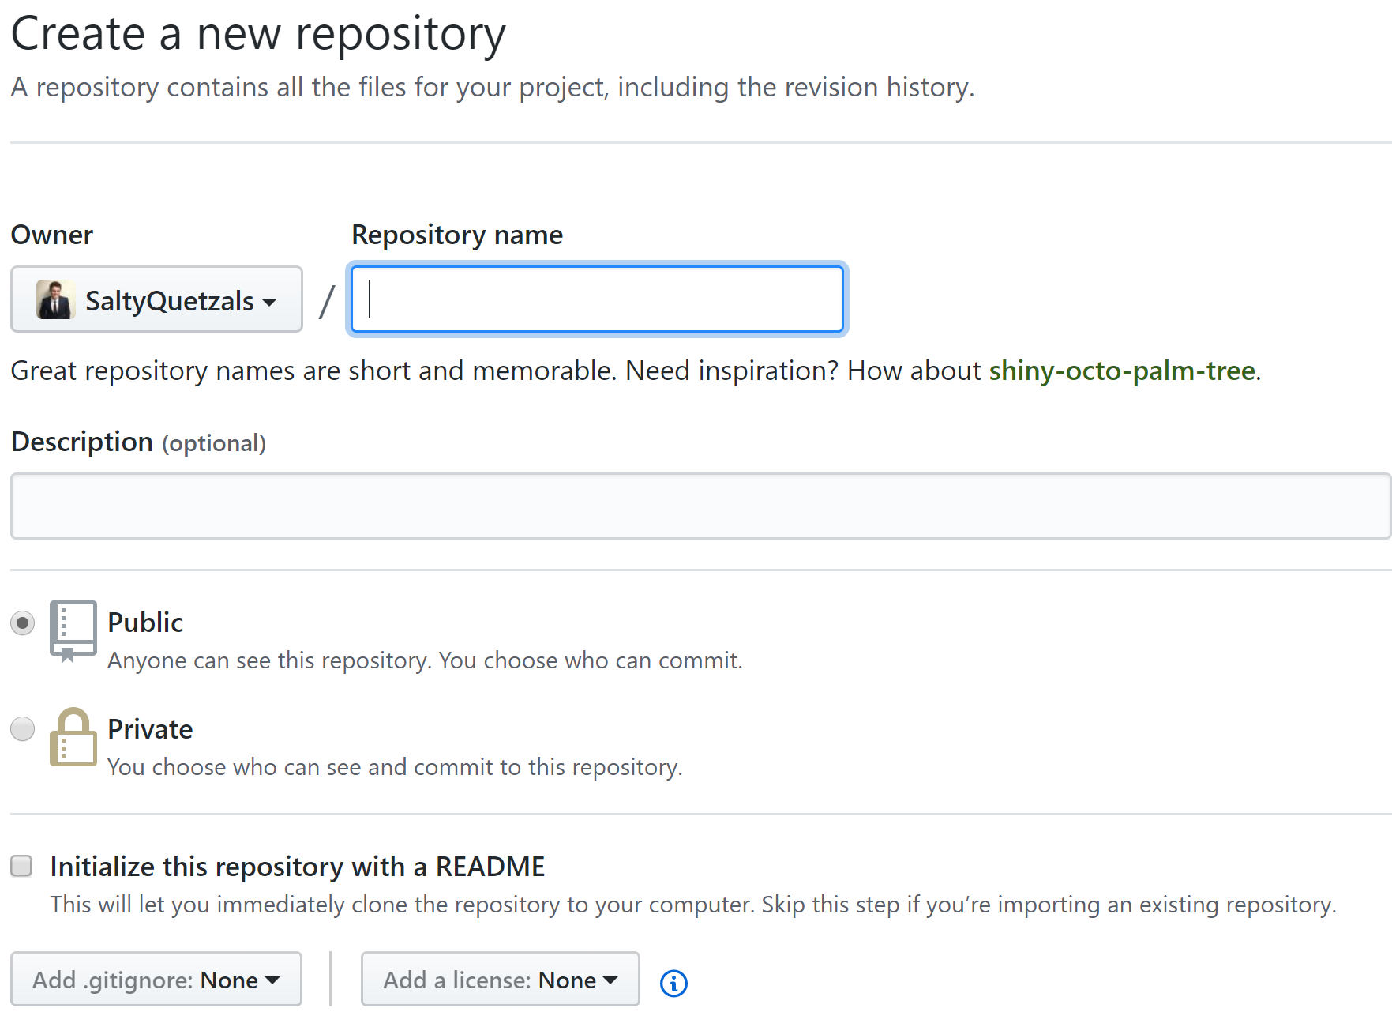
MAKING A REPOSITORY

Slide 12
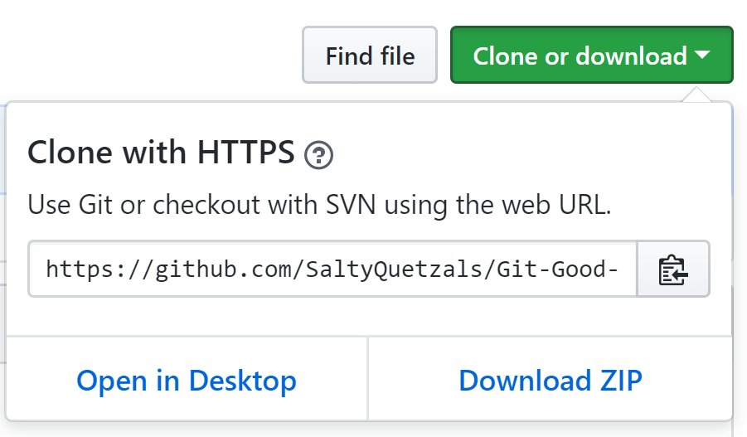
CLONING
cd /to/desired/directory/
git clone <https|ssh>
Copy the URL to your clipboard!
Notes:
Have everybody clone the repository
Make a change to the README.md, and commit it.

Slide 13



CLONING
Notes:
1. This is just a visualization of cloning, where you take a repository stored on a remote host, and then put it on your computer, creating a symbolic link to the repository on the remote host for further modification.

Slide 14
PUSHING
git push
(Requires commit)
Notes:
You cannot push unless you’ve made a commit.
(Make modifications on local and commit/push)

Slide 15


PUSHING
Notes:
This is just a visualization of pushing.
After making modifications to a cloned repository, committing the code and pushing it will then bring the repository on the remote host up to date.

Slide 16
PULLING
git pull
(Requires change on remote)
Notes:
Pulling is how you synchronize code locally to code stored on a remote repository.
Before you start working on any code, always make sure to pull first, otherwise you’ll be working with outdated code which could have changed significantly.

Slide 17
PULLING
Notes:
1. This is just a visualization of pulling a repository, where outdated code on your computer is updated with code located on a remote host.

Slide 18
BRANCHING
git branch <branch-name>
git checkout <branch-name>
Notes:
Branching is an excellent way of keeping your code from impacting the code that other people work with until you’re sure that it’s ready to.
The “branch” command creates the requested branch
The “checkout” command allows you to switch to the specified branch to modify code on it. To switch back to the original branch, just “checkout” that branch.

Slide 19
D
H
git checkout my-branch
C
G
git branch my-branch
B
F
you
my-branch
you
A
master
Notes:
This is just a visualization of branching.
The master branch (the root branch of the repository) is an extremely important branch that should only have working code on it.
Thus, you want to make any experimental code on its own branch, so that way if it breaks, it doesn’t break on master, and then later on bring that code (once you’re sure that it works) in.
But how do you bring it in?

Slide 20
MERGING
git merge <target-branch>
That-to-this
Notes:
Merging is how you bring branched code into another branch.
Say for example, that I’m on the master branch, and I want to merge my-branch’s changes into master.
You checkout master, and git merge my-branch
It’ll merge!

Slide 21
E
D
H
C
G
B
F
my-branch
A
master
Notes:
So here’s how merging looks once it’s completed!
Many people will protect their master branch
Many times you’ll have to make a pull request, where you have to have your changes approved by other members of your project.
And that looks like this! ->

Slide 22
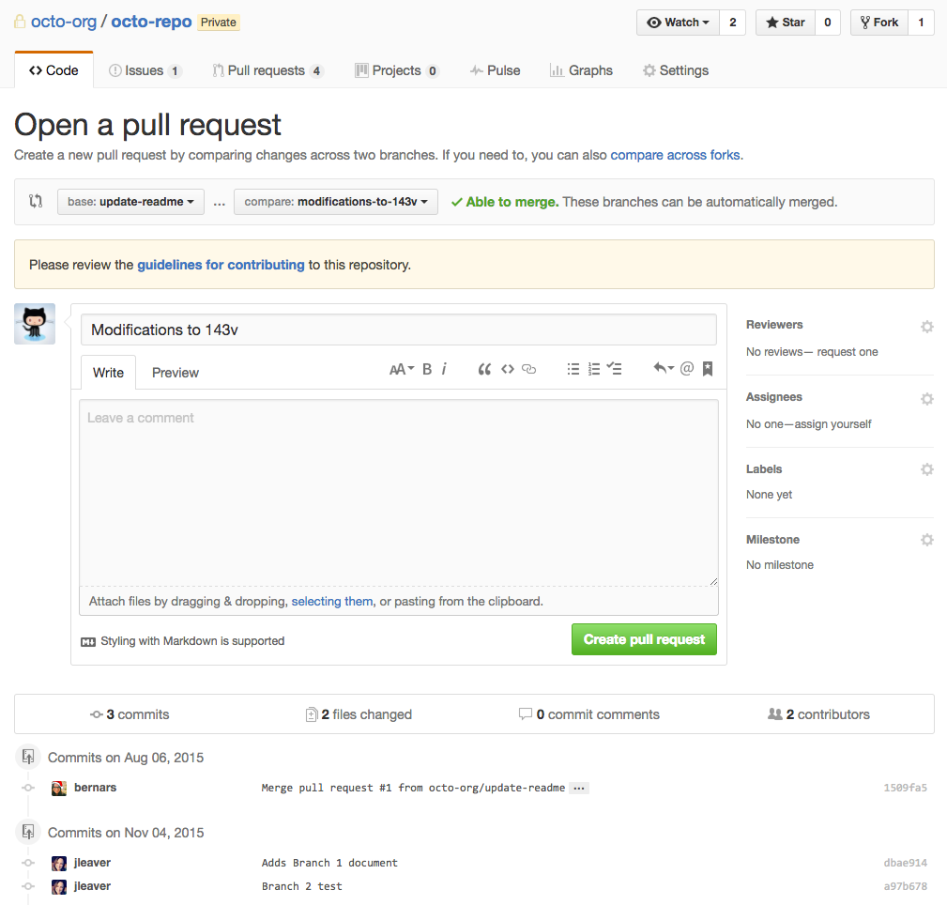
Notes:
Base and compare (branch to merge into & merging branch)
Reviewers
Assignees
Labels
Milestones

Slide 23

CONFLICT (content): Merge conflict in <file_name> Automatic merge failed; fix conflicts and then commit the result.
Notes:
Merge conflicts are a pain, but they’re survivable and they’re a great way for you to reevaluate your code.
They look really scary, but they’re actually quite simple.
Let’s break it down.

Slide 24
Which to use?
1 | This is in GitHub
1 | This is in my computer
pull
Notes:
Merge conflicts occur when you have two different users who modify the same sections of code.
Take for example these two lines of code: Both users modified line one.
How is Git supposed to know which version to use?

Slide 25
MERGE CONFLICTS
<<<<<<<<<<<<<<<<<<< HEAD
//Their code
===================
//Your code
>>>>>>>>>>>>>>>>>>>/some/dir/structure
They’re survivable
Notes:
Merge conflicts look like this:
Left brackets followed by HEAD (which indicates their code)
A series of equals signs, indicating the change from their code to your code
Right brackets, which indicates the end of the merge conflict.

Slide 26
OTHER STUFF
git diff
git status
git reset [--hard]
git revert <commit>
That doesn’t really fit in

Slide 27
GIT

Slide 28
Questions?

